Slide 1





Barbell
An Extensible Generator of On-Demand Loads for Interactive Cloud Services
Yuxuan Liu¹, Yeh-Ching Chung¹, Shuang Chen²
Speaker: Yuxuan Liu¹
¹Chinese University of Hong Kong, Shenzhen
²Huawei Cloud, Shuhai Lab
APPT 2026

Slide 2
Introduction
Load Generator
  What: A tool designed to simulate realistic user behavior and traffic patterns
  How: Spawn workers to interact with system under test (SUT), and reports key system metrics
  Why: Help evaluate system performance, scalability, and reliability under realistic load
Worker A
RDBMS
Key System
Metrics
reports
Load
Generator
spawns
Web Search
Worker B
Worker C
Caching
Fig 1. Overview of a Load Generator
Notes:
Animation Needed

Slide 3
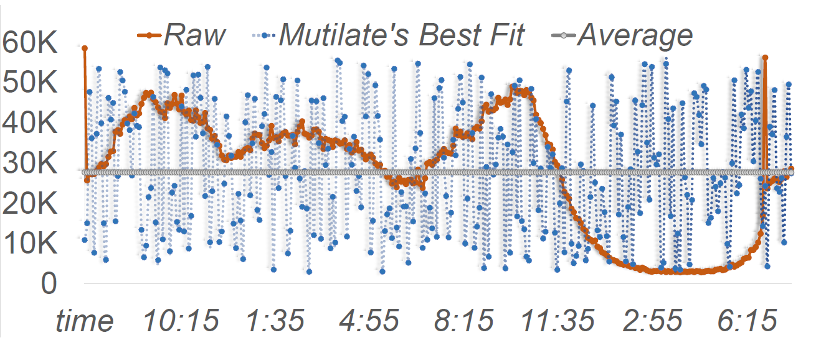
Barriers of Load Generators for Interactive Cloud Services
Idealized Load Intensity
  Limited load patterns
    Stable or peak load in RPS only.
    Statistical distribution model fit.
Dedicated Workload Logic
Fig 2. A 24h key-value store trace segment on Huawei Cloud
Notes:
1. 诸如YCSB，Lancet等都注重实现Open-Loop的负载生成，但RCP要同时兼顾三种，且以往研究证明partly-open-loop才是最符合现实情况的。

Slide 4
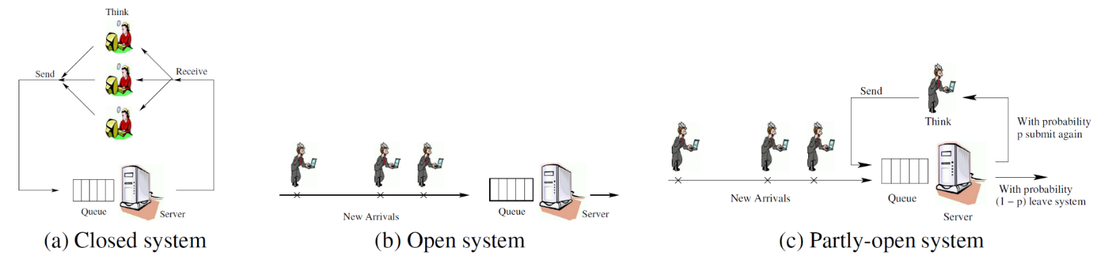
Barriers of Load Generators for Interactive Cloud Services
Idealized Load Intensity
  Limited load patterns
    Stable or peak load in RPS only.
    Statistical distribution model fit.
  Incomplete support of request control policy
    Open-Loop & Closed-Loop & Partly-Open-Loop
    Coordination Emission → Latency Underestimation
Dedicated Workload Logic
Fig 3. Three Types of Request Control Policy
Fig3 Courtesy: Schroeder, B., Wierman, A., & Harchol-Balter, M. (2006). Open versus closed: A cautionary tale.
4
Notes:
1. 诸如YCSB，Lancet等都注重实现Open-Loop的负载生成，但RCP要同时兼顾三种，且以往研究证明partly-open-loop才是最符合现实情况的。

Slide 5
Barriers of Load Generators for Interactive Cloud Services
Idealized Load Intensity
  Limited load patterns
    Stable or peak load in RPS only.
    Statistical distribution model fit.
  Incomplete support of request control policy
    Open-Loop & Closed-Loop & Partly-Open-Loop
    Coordination Emission → Latency Underestimation
Dedicated Workload Logic
  Limited service-type extensibility
    Service-type-specific dedication
    Huge evaluation cost
    Handcrafted client / protocol given available commodity
    Poor system compatibility
Our work:
How to design an extensible generator of on-demand loads
(fully decoupled & strong compatibility)
5
Notes:
1. 诸如YCSB，Lancet等都注重实现Open-Loop的负载生成，但RCP要同时兼顾三种，且以往研究证明partly-open-loop才是最符合现实情况的。

Slide 6
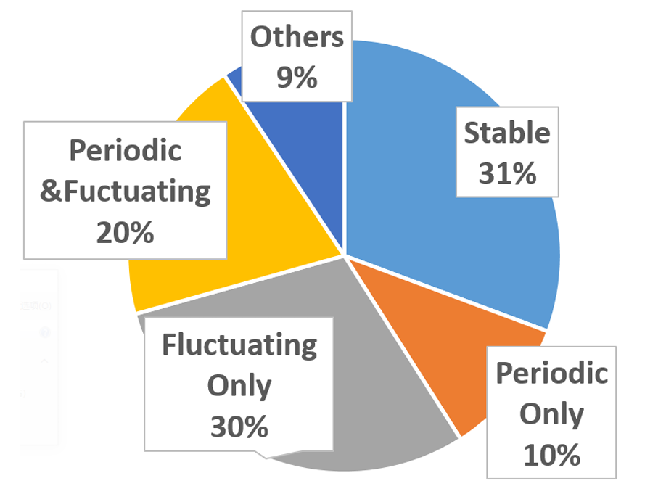
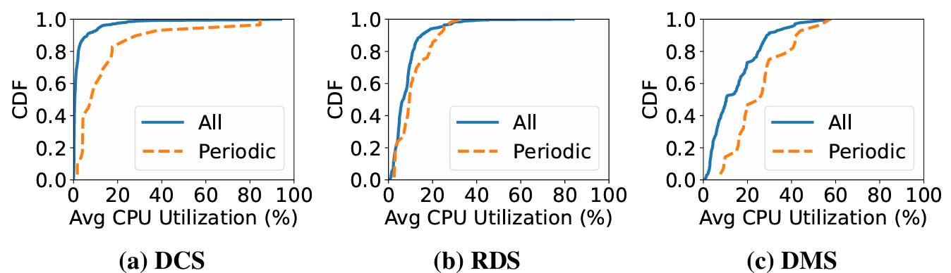
Workload Characterization on Huawei Cloud
Dataset
  RDS: Relational Database Service (e.g., MySQL)
  DMS: Distributed Messaging Service (e.g., Kafka)
  DCS: Distributed Caching Service (e.g., Memcache)
  20 Tenants × 50 VMs × 1 week
Fig 4. Distribution of VM Types
Key Takeaways:
1. Load intensity is mostly small to medium.
2. Load variation shows periodic, diurnal,
and fluctuating patterns.
Fig 5. CDF of Average CPU Utilization
Notes:
Animation Needed

Slide 7
Observations & Key Insights
Observations
  Real-world loads are unstable with complex patterns and in various metrics.
Key Insights
  Load intensity generation in a combinatorial way
Notes:
1. We performed a workload characterization
2. the services they work for barely operate at full or stable load
Client Type: Sync vs. Async
Client Impl: handcrafted vs. commodity
Protocol Type: Stateful vs. Stateless

Slide 8
Observations & Key Insights
Observations
  Real-world loads are unstable with complex patterns and in various metrics.
  Number of in-flight requests determines request control policy.
    Only 1: Closed-Loop, Unlimited: Open-Loop, Multiple: Partly-Open-Loop
Key Insights
  Load intensity generation in a combinatorial way
  Decoupled request management with in-flight request queue
Notes:
1. We performed a workload characterization
2. the services they work for barely operate at full or stable load
Client Type: Sync vs. Async
Client Impl: handcrafted vs. commodity
Protocol Type: Stateful vs. Stateless

Slide 9
Observations & Key Insights
Observations
  Real-world loads are unstable with complex patterns and in various metrics.
  Number of in-flight requests determines request control policy.
    Only 1: Closed-Loop, Unlimited: Open-Loop, Multiple: Partly-Open-Loop
  Limited types of services on client, implementation, and protocol
    Client: Sync vs. Async, Impl: Handcrafted vs. Commodity, Service Protocol: State-ful/-less
Key Insights
  Load intensity generation in a combinatorial way
  Decoupled request management with in-flight request queue
  Abstraction of service extension with several popular models
Notes:
1. We performed a workload characterization
2. the services they work for barely operate at full or stable load
Client Type: Sync vs. Async
Client Impl: handcrafted vs. commodity
Protocol Type: Stateful vs. Stateless

Slide 10
Barbell: System Overview
Load Specification
Evaluation Report
RPS Time Series
Multi-Pass Load Intensity Generator
Load Executor
Trace A
Trace X
Trace B
Inter-Arrival Gap Generator
Workload
Logic
Generator
Synthesis Pass
Replay Pass
Request Scheduler
Time Series (IR)
Custom
Pass
Pipeline
Hook
Segment-Wise
Aggregation Pass
Time Series (IR)
Connection Manager
(in-flight request queue)
Service Client
(Sync/Async)
Callback
Time Series (IR)
Profile
Guided
Service Protocol
(State-ful/-less)
Custom Pass
(e.g., Periodicity)
Resource-to-RPS
Conversion Pass
Recorder
General Functionality
Service-Specific
Functionality
Fig 6. Overall System Design of Barbell
Notes:
Animation Needed

Slide 11
Single-Pass vs. Multi-Pass
Single-Pass (All-in-One)
Multi-Pass (Fully Decoupled)
Dedicated Load Intensity
Generator
Load Gen
Frontend
Load Pattern #1
Load Pattern #2
Load Pattern #3
Dedicated Load
Executor
General-Purpose
Load Executor
Dedicated Service
Client & Protocol
Load Gen
Backend
Service #A
Service #B
Service #C
Highlights of Multi-Pass:
1. Fully reuse the core load execution infrastructure.
2. Low development cost on new load patterns and SUT.
Notes:
Animation on “frontend” and “backend”
Mention two Irs, one is load time series, and the other is interface call
For the first IR part, we are the first to make this attempt to the best of our knowledge
For the IR in the backend, many previous work also use this method, but we move one step further to elaborate on multiple popular service extension models

Slide 12
Load Intensity Generation Passes
Entrance Passes
  Synthesis Pass
    Model variation with statistical distributions
  Replay Pass
    Reproduce the input trace
Transformation Passes
  (Static) Segment-Wise Aggregation Pass
    Merge multiple loads as one load with segments
  (Dynamic) Resource-to-RPS Conversion Pass
    Iteratively launch trial runs for profiling
    Dynamically convert loads from resource utils (e.g., CPU) to RPS
Load Configs
Entrance Pass(es)
(Singular Pattern)
Transformation Pass(es)
(Composite Pattern)
Transformation Pass
(Convert to Load in RPS)
RPS Time Series
Fig 7. A Standard Pass Pipeline
Notes:
Animation Needed

Slide 13
General-Purpose Request Management
General Functionality
Service-Specific Functionality
Activate
Hooks
Ready
Workload Logic
Generator
Inter-Arrival
Gap Generator
Waiting
Scheduled
Issued
Recorder
Dump
Recorded
In-Flight
Service Client
Completed
Callbacks
Fig 8. Request Lifecycle in Barbell
Highlights:
1. Decouple request control policy implementation with SUT.
2. Easy service extension though hook and callback interfaces.
Notes:
Animation Needed

Slide 14
Service Extension Models (1/4)
Extension Model A
  Client Type: Async
  Client Impl: Handcrafted
  Protocol Type: Stateless
  Use Scenario:
    Simple service protocol
    Extremely high throughput
  Services in Use in Barbell:
    Redis (RESP)
    Memcache (Text / Binary)
General
Function-
ality
issue_req
Request
App Protocol
I/O Stream
issued_cb
Socket
TX
RX
recv_cb
Fig 9: Extension Model A:
Async Handcrafted Client & Stateless Protocol
Notes:
Animation Needed

Slide 15
Service Extension Models (2/4)
Extension Model B
  Client Type: Async
  Client Impl: Commodity Tools
  Protocol Type: Stateless
  Use Scenario:
    Complicated protocol
    High throughput
  Services in Use in Barbell:
    Nginx (HTTP) & libevent evhttp
    vLLM (HTTP) & libevent evhttp
General
Function-
ality
issue_req
Request
API
Async Client
Commodity
Multi--plexer
issued_cb
Socket
TX
RX
recv_cb
Fig 10: Extension Model B:
Async Commodity Client & Stateless Protocol
Notes:
Animation Needed

Slide 16
Service Extension Models (3/4)
Extension Model C
  Client Type: Async
  Client Impl: Commodity Tools
  Protocol Type: Stateful (broker)
  Use Scenario:
    Client has to maintain states.
    Require periodic pooling to sync states.
  Services in Use in Barbell:
    Kafka (Binary) & librdkafka
General
Function-
ality
issue_req
Request
API
Poll
Async Client
Commodity
Poll
issued_cb
Event Loop
recv_cb
Fig 11: Extension Model C:
Async Commodity Client & Stateful Protocol
Notes:
Animation Needed

Slide 17
Service Extension Models (4/4)
Extension Model D
  Client Type: Sync
  Client Impl: Commodity Tools
  Protocol Type: Stateul
  Use Scenario:
    Complicated, stateful protocol
    ACID requirement
  Services in Use in Barbell:
    MySQL & C++ Connector
General
Function-
ality
issue_req
Request
Wait
Sync Client
Commodity
Inter--leave
issued_cb
Thread Pool
recv_cb
Fig 12: Extension Model D:
Sync Commodity Client & Stateul Protocol
Notes:
Animation Needed

Slide 18
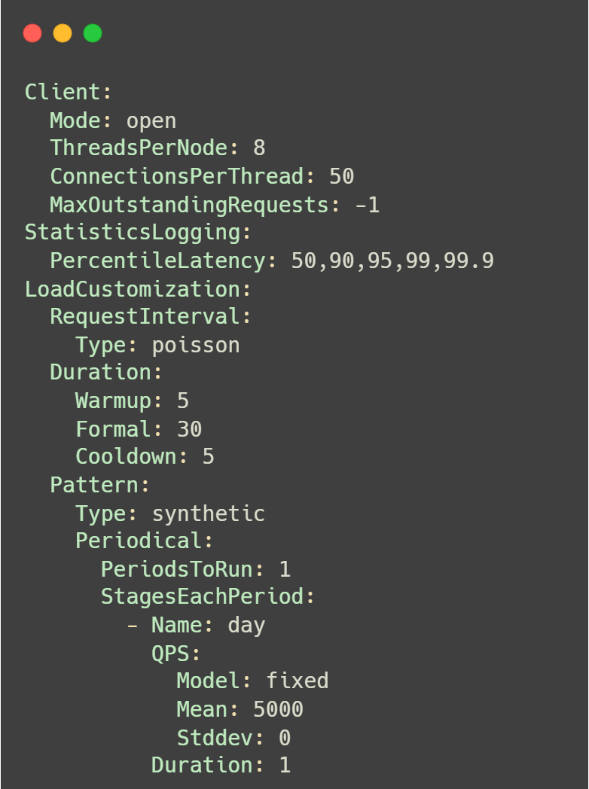
Evaluation: Setup
Compute & Memory
  Intel Xeon Silver 4210 @ 2.40GHz
    20 Cores / 40 Threads on 2 Sockets
  96GB of DDR4
OS: Ubuntu-20.04-LTS
Networking
  Intel I350 Gigabit Network Connection
Docker Deployment
  Client: 16-core container each
  Server: 4-core container each
    Service Config: 4 Workers
Fig 14. Sample Segment of Barbell’s YAML Config
Notes:
Animation Needed

Slide 19
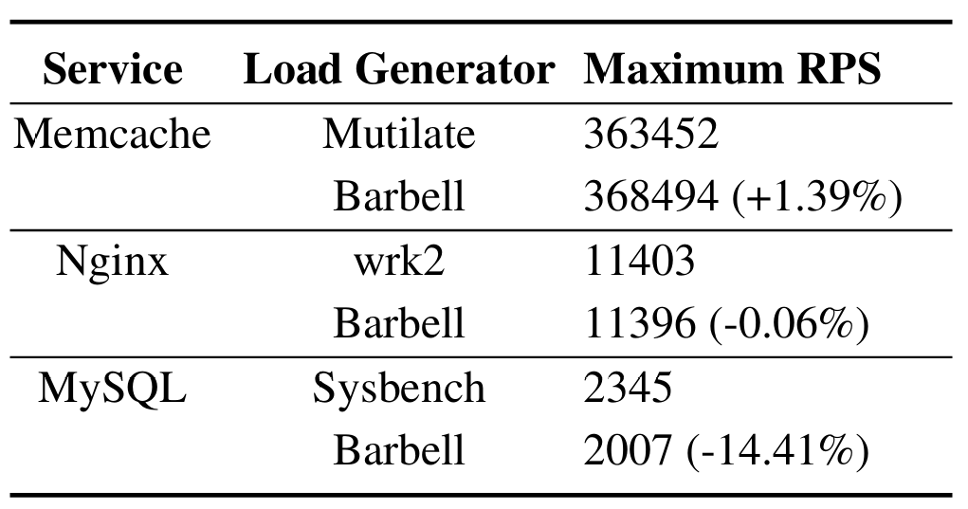
Evaluation: Max Closed-Loop Throughput
Table 1: Comparison of Max Closed-Loop Throughput
Highlight:
1. Barbell achieves comparable throughput to service-specific SOTA.
Notes:
Animation Needed

Slide 20
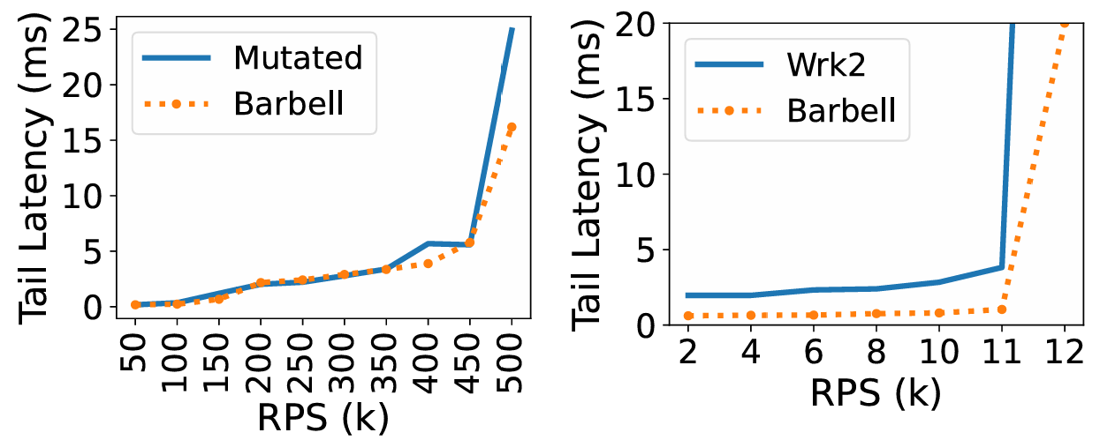
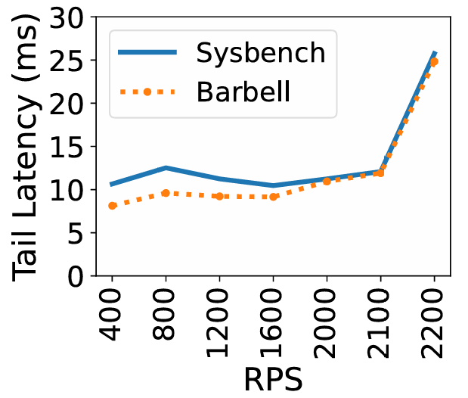
Evaluation: Open-Loop Latency Measurement
Fig 15. 99th Percentile of latency (tail latency) with increasing RPS.
Highlight:
1. Barbell accurately measures latency under both low and extremely high throughput (server-side queueing delay).
2. Barbell achieves lower client-side jitters.
Notes:
Barbell can record the number of requests blocked that were not issued on time
By using busy-spinning model for open-loop load generation, clients-side jitters

Slide 21
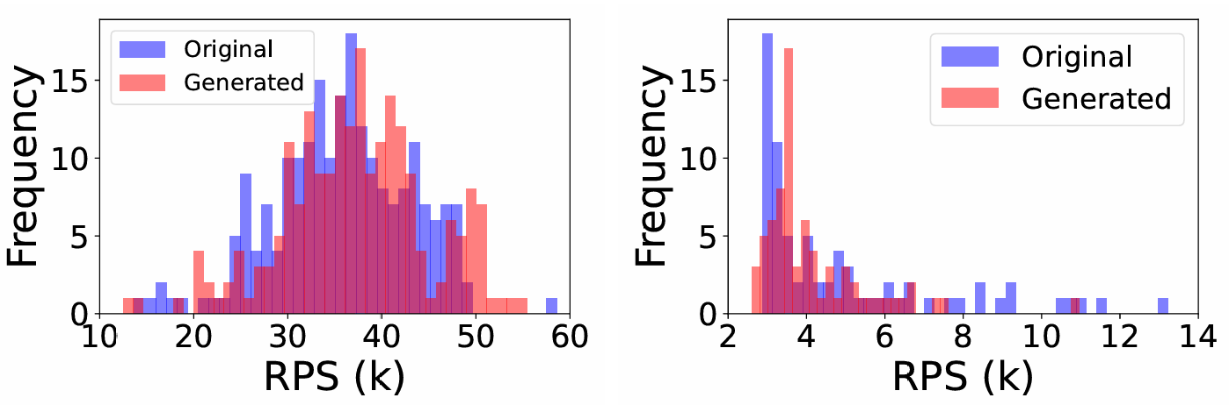
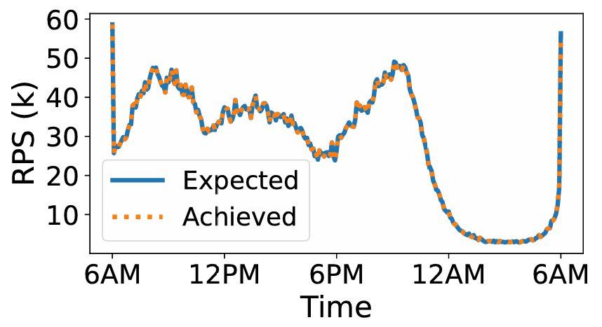
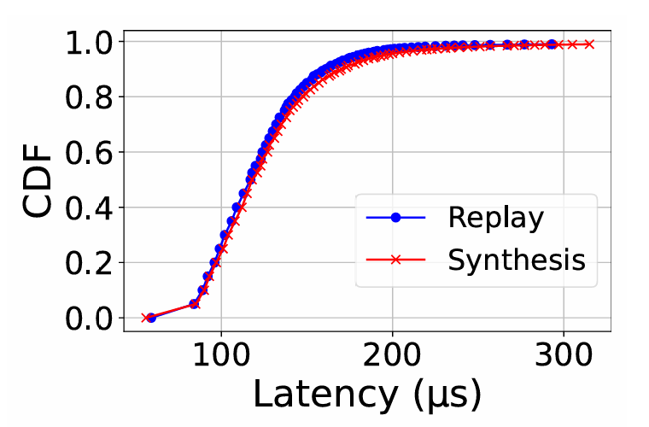
Evaluation: Complex Load Pattern Generation (Fig 2)
Pipeline 1: 2 Synthesis Passes + Segment-Wise Aggregation Pass
Highlight:
1. Barbell can generate complex loads via custom pass pipelines.
2. Barbell supports both load synthesis and replay modularly.
Pipeline 2: Replay Pass Only
Notes:
Should I add another highlight point here?

Slide 22
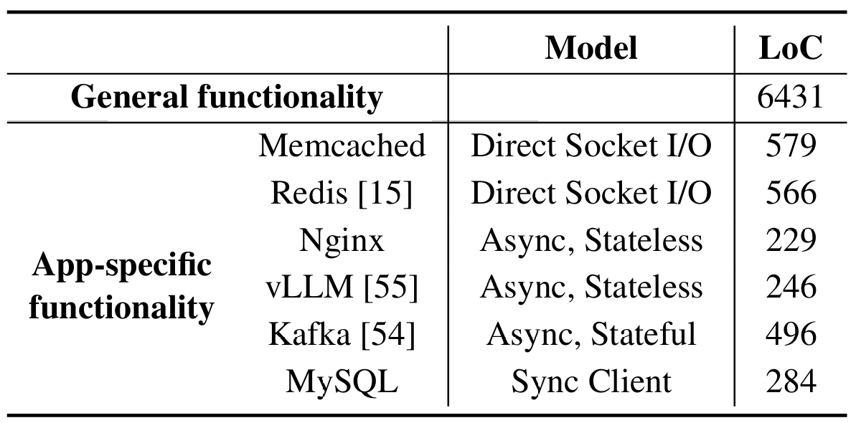
Evaluation: Simplicity of Extensibility
Table 2: Decomposition of Barbell’s LoC.
Highlight:
1. Barbell’s fully decoupled system design saves most developing efforts (73%) are on general logic.
Notes:
SSH as a separate service extension that serves to collect server-side resource utilization

Slide 23
Future Work
Finer-Grained Pass Design
  Hierarchical data accessibility of each type of pass
  Add more passes, e.g., Analyze Passes for automatic workload characterization
Unified Workload Logic Specification
  Lua scripts causes performance lost, and workload logic is in black-box.
  Need of load-generator-aware workload logic specification.
  Preferably a structured representation of control flow
Notes:
Recall LLVM’s pass design, there are module pass, function pass, loop passes. Each type of pass only works for specific code range. Compared to LLVM, Barbell’s pass design is still like a baby.

Slide 24

Conclusion
Barbell
  Fully decouples load intensity generation and service extension with general functionalities.
  Proposes a multi-pass framework to generate real-world patterns in a combinatorial way.
  Designs an extensible architecture for services with distinct types of protocols and clients.
Instructions & Docker Containers are Open on GitHub https://github.com/tonyyxliu/Barbell
Welcome Q&A!
Notes:
Animation Needed

